Slide 1


A PROJECT PRESENTATION
PARK EASE
USING JAVA
Presented by
Submitted To:
Page 1
Akuthota Rakesh Kumar - Emp id: 4742
Sathish Kumar Paramasivam Sir

Slide 2
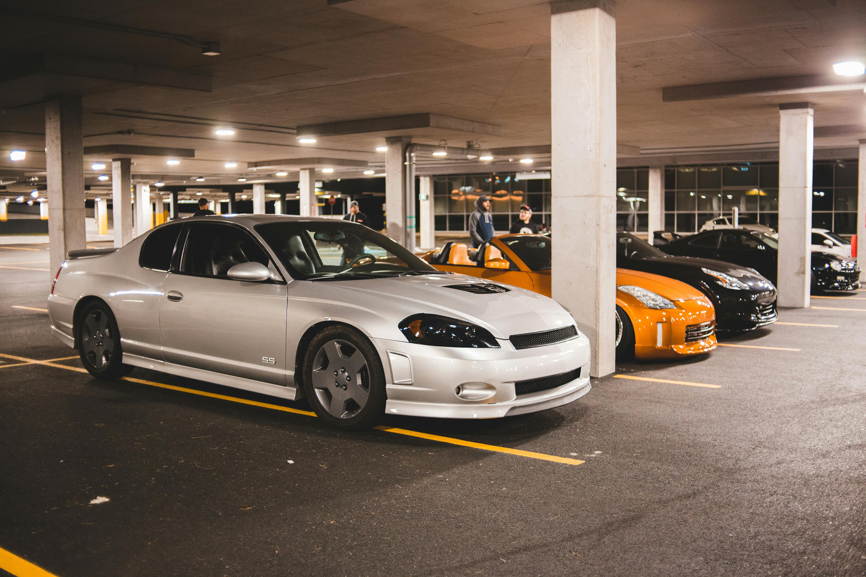

PARK EASE
Introduction
Park Ease
Parking management in busy areas faces challenges like limanual errors, and delays.
Automated systems provide quick slot allocation, accurate charge calculation, and organized record keeping,
Page 2

Slide 3
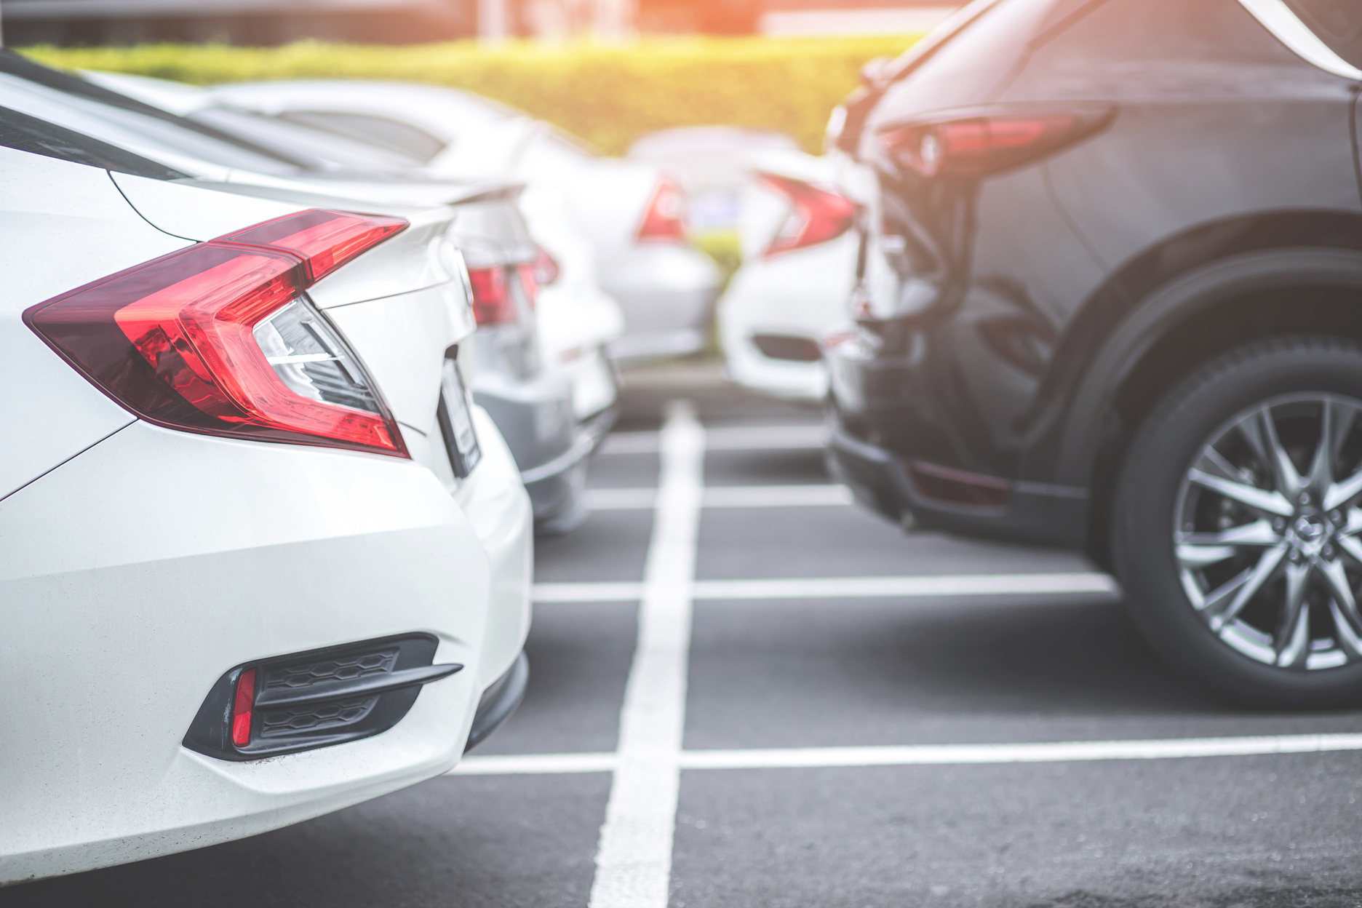
PARK EASE
Objective
Objectives
Ensure efficient vehicle parking operations
Minimize manual intervention
Provide fast and accurate check-in/check-out
Maintain clear parking slot records
Generate fare receipts instantly
Page 3

Slide 4
Park Ease
Technologies
Used
Programming Language
Interface
Abstraction
Inheritance
Encapsulation
Java
Nested Class
Static Members
File Handling
Page 4

Slide 5
Park Ease
Slot Management
Vehicle Validation
First-come-first-serve allocation
Ensures proper vehicle format
Key
Charge Calculation
CSV Record Keeping
Features
Based on type & hours parked
Permanent storage
Optional Receipt Printing
For user confirmation
Page 5

Slide 6

Park Ease
Encapsulation
Private fields with getters/setters
Code
Abstraction & Inheritance
Highlights
Vehicle hierarchy
Interface Implementation
ParkingOperations
Static Variable
Tracks revenue/slot count
Nested Class
Page 6
Slot management

Slide 7

PARK EASE
SOLID Principles
Single Responsibility Principle (SRP)
Each class has one clearly defined responsibility:
Vehicle handles vehicle-related properties.
ParkingLot manages parking slots and operations.
SimpleVehicle specifies concrete vehicle behavior.
Liskov Substitution Principle (LSP)
Any subclass of Vehicle (e.g., SimpleVehicle) can replace the parent class without breaking functionality.
Page 7

Slide 8
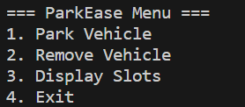
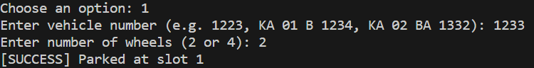
Park Ease
Output
Screenshot
Page 8

Slide 9
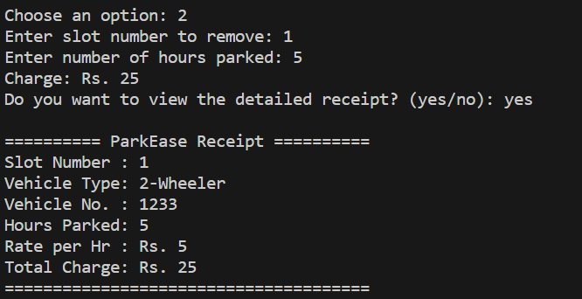
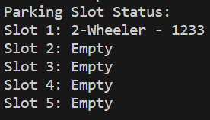
Park Ease
Output
Screenshot
Page 9

Slide 10

Park Ease
Thank
You!
GitHub Repository Link
Page 10

